Slide 1
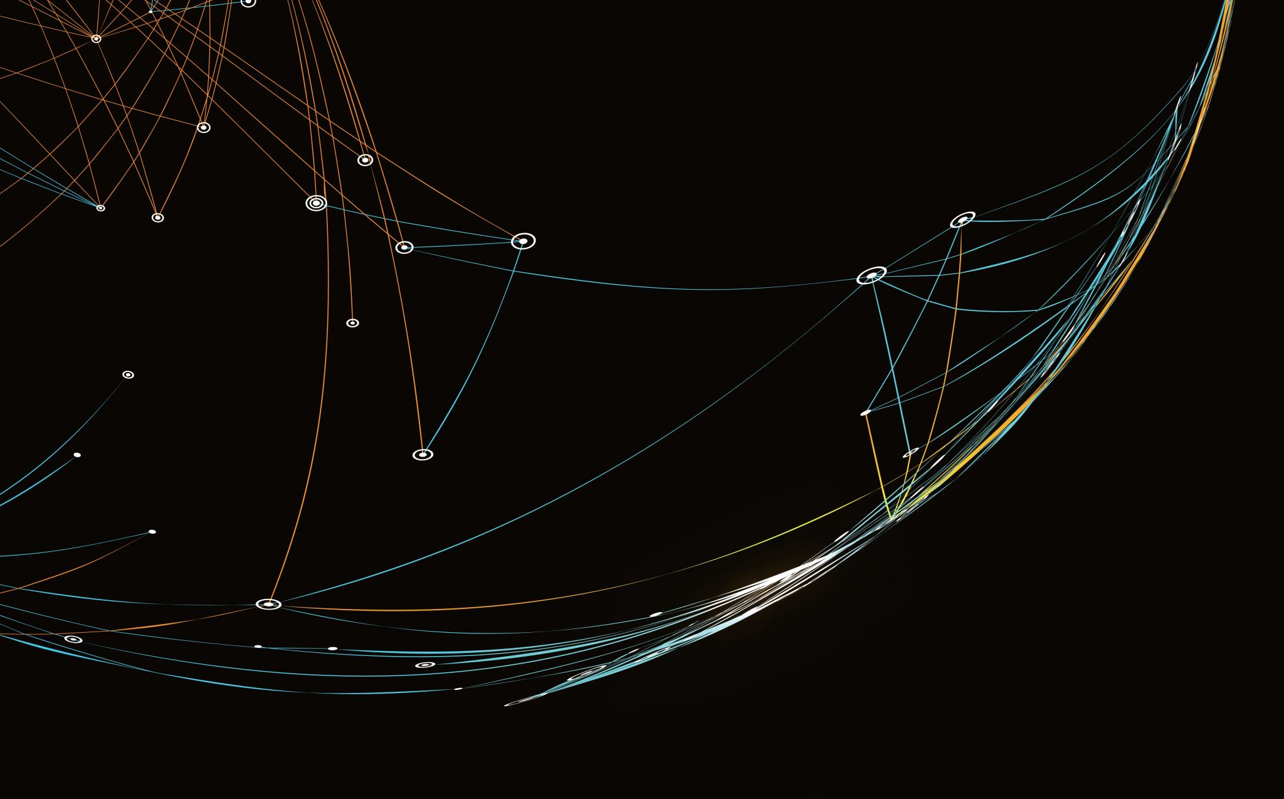
THIEF
Group-15
Rashmika Adusumilli -11770425 Jathin Reddy Singamala -11715800 Avinash Uppalapati -11757775 Vaishnavi Vangala -11717387

Slide 2
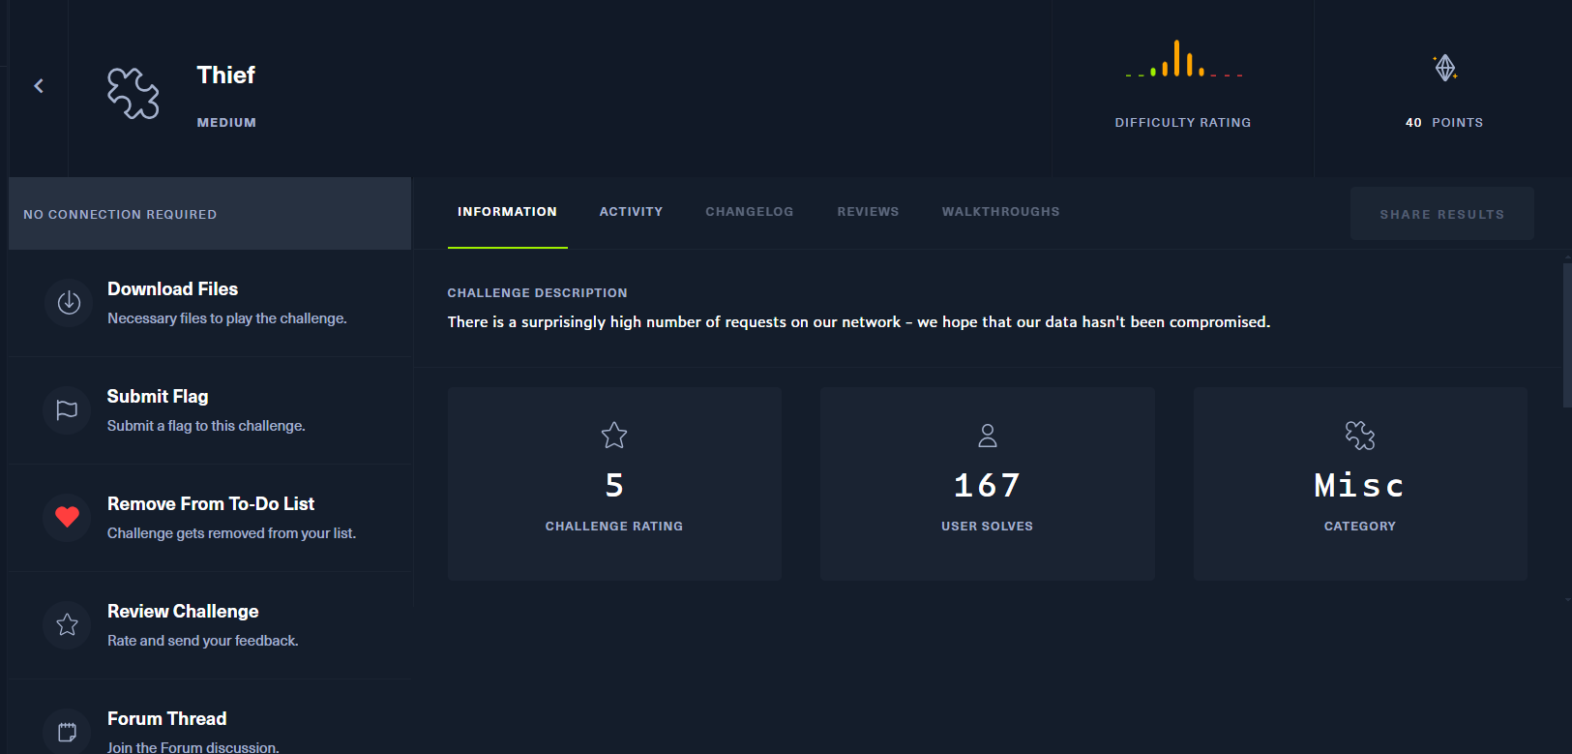

Slide 3
ABOUT THE CHALLENGE
After downloading and unzipping file, found a PCAP file.
Challenge is to analyze the network requests and understand it.

Slide 4
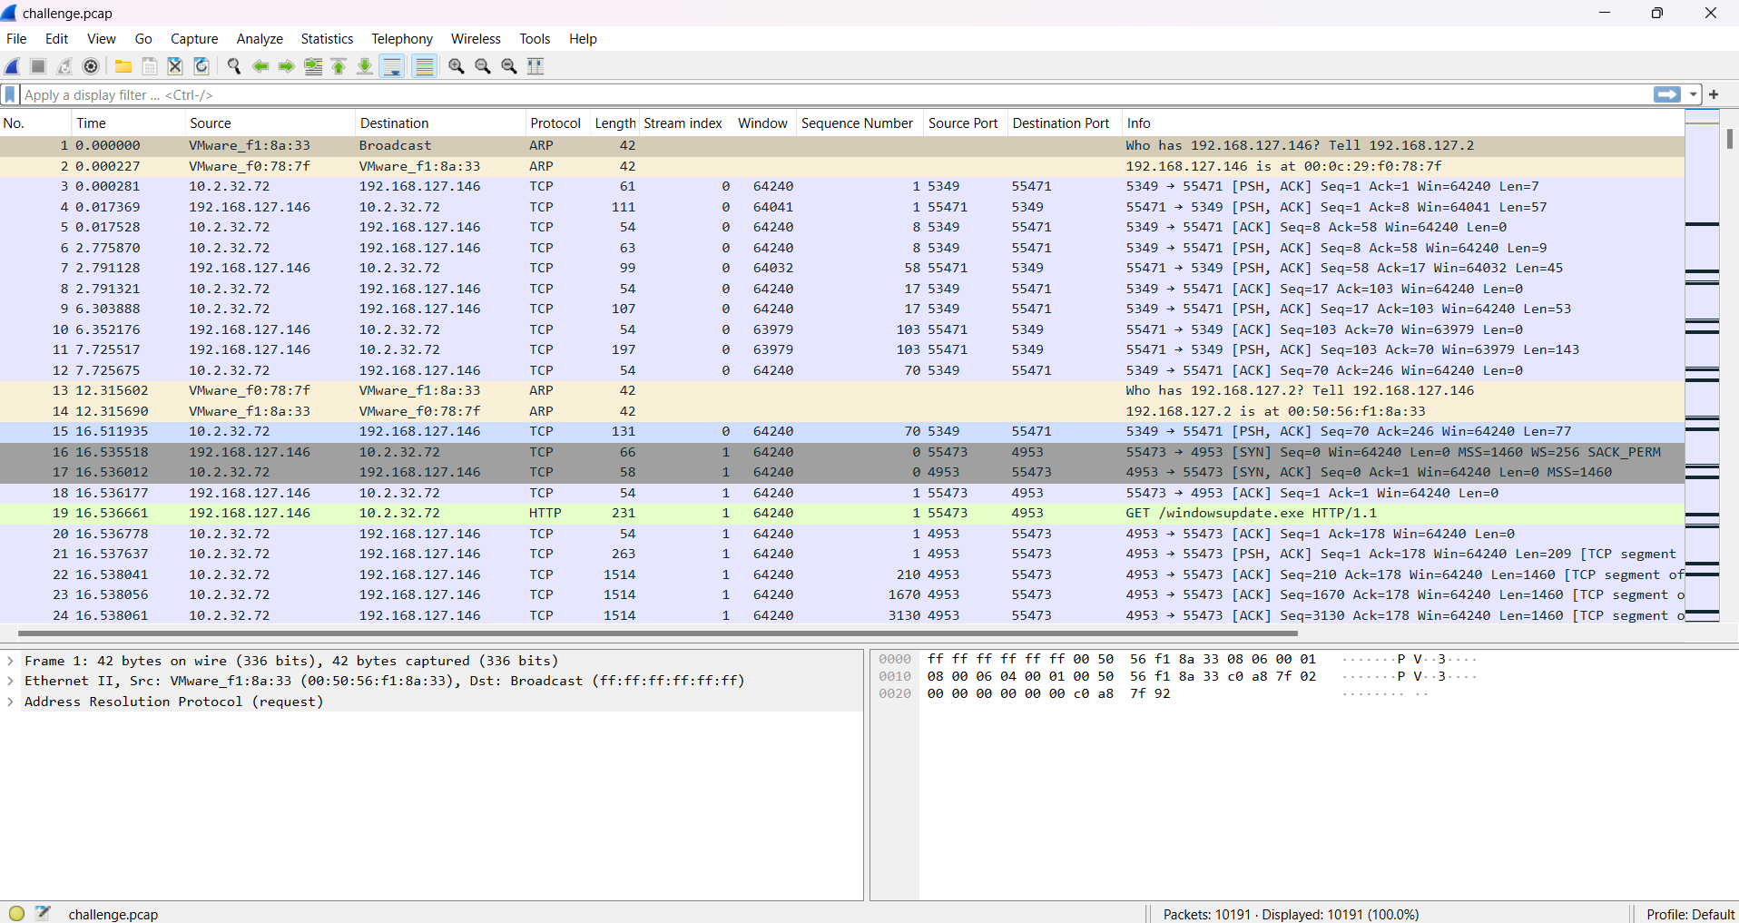
Wireshark
Wireshark is used to analyze the PCAP files.
Source indicates where the request initiated.
Destination indicates where the request is sent to.
Stream Index is used to uniquely identify the TCP stream.

Slide 5
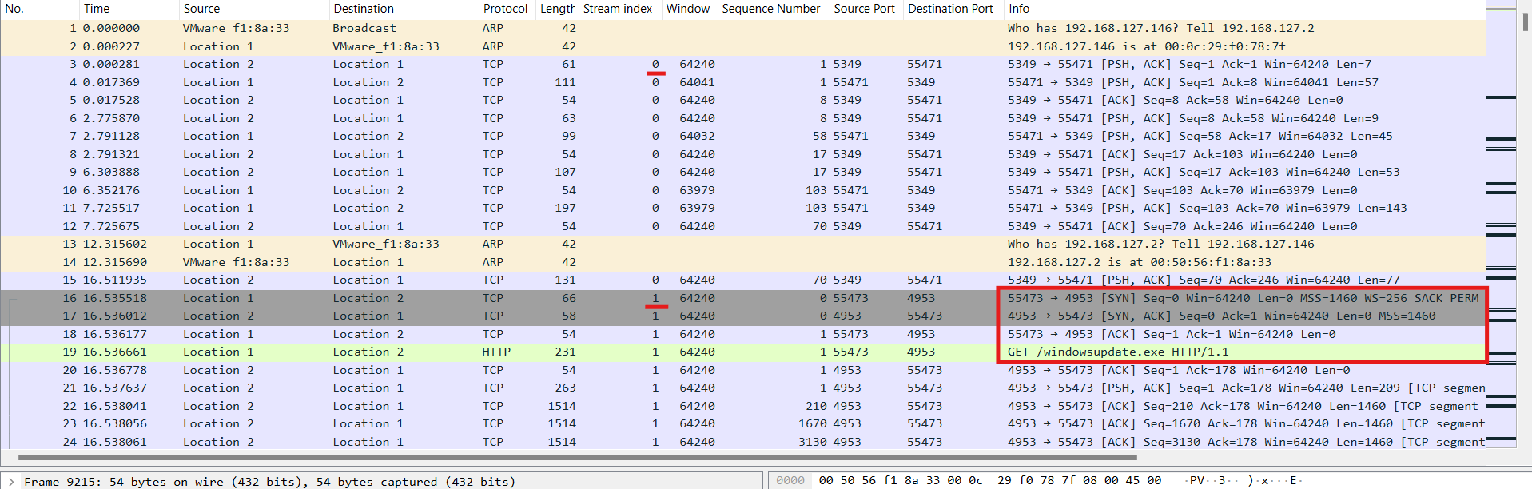
Analysis from Wireshark
SYN – Packets to Initiates a Connection.
ACK – Packets to confirm initiation request and confirm data packets are received.
FIN – Indicate connection is being torn down.

Slide 6
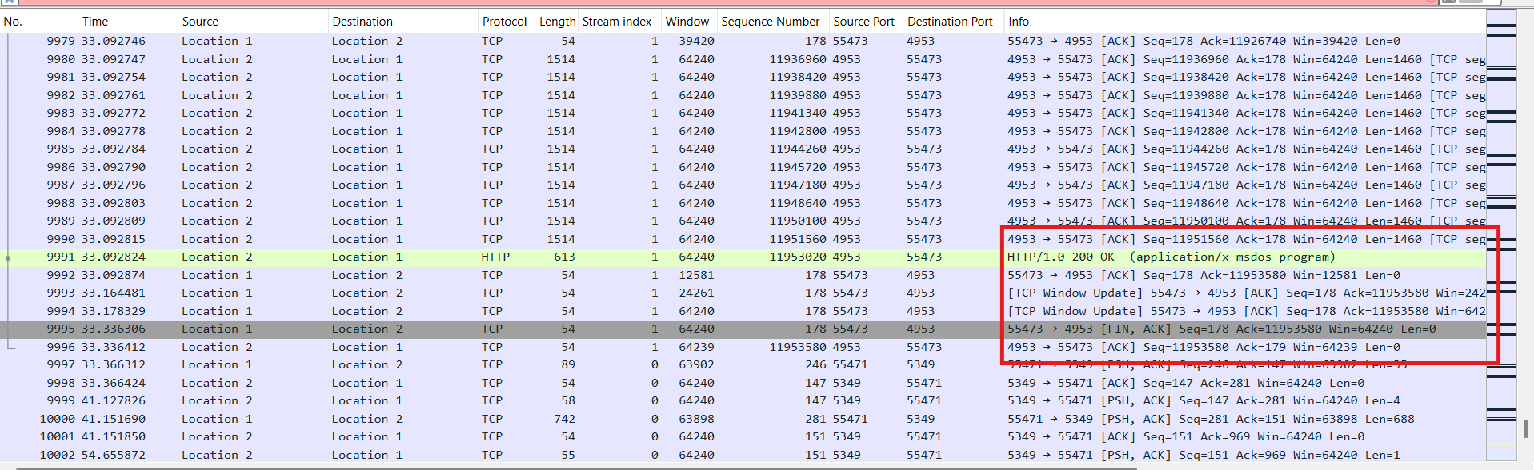
Location 1 – 192.168.127.146
Location 2 – 10.2.32.72
HTTP GET request was initiated from Location 1 to Location 2.
Stream Index 1 indicates all the data transfer that is related to windowsupdate.exe
Download the windowsupdate.exe file from File => Export Objects => HTTP.

Slide 7
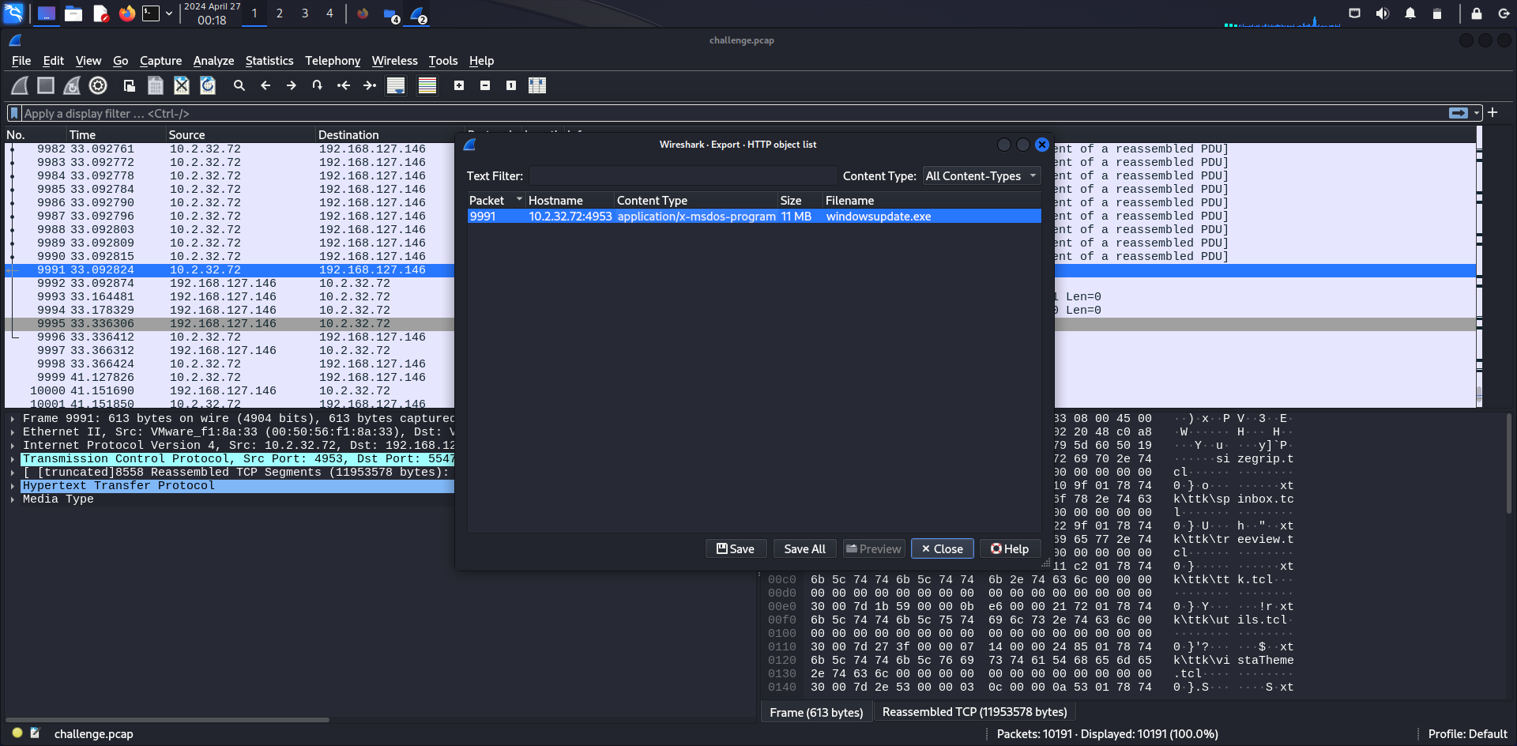

Slide 8
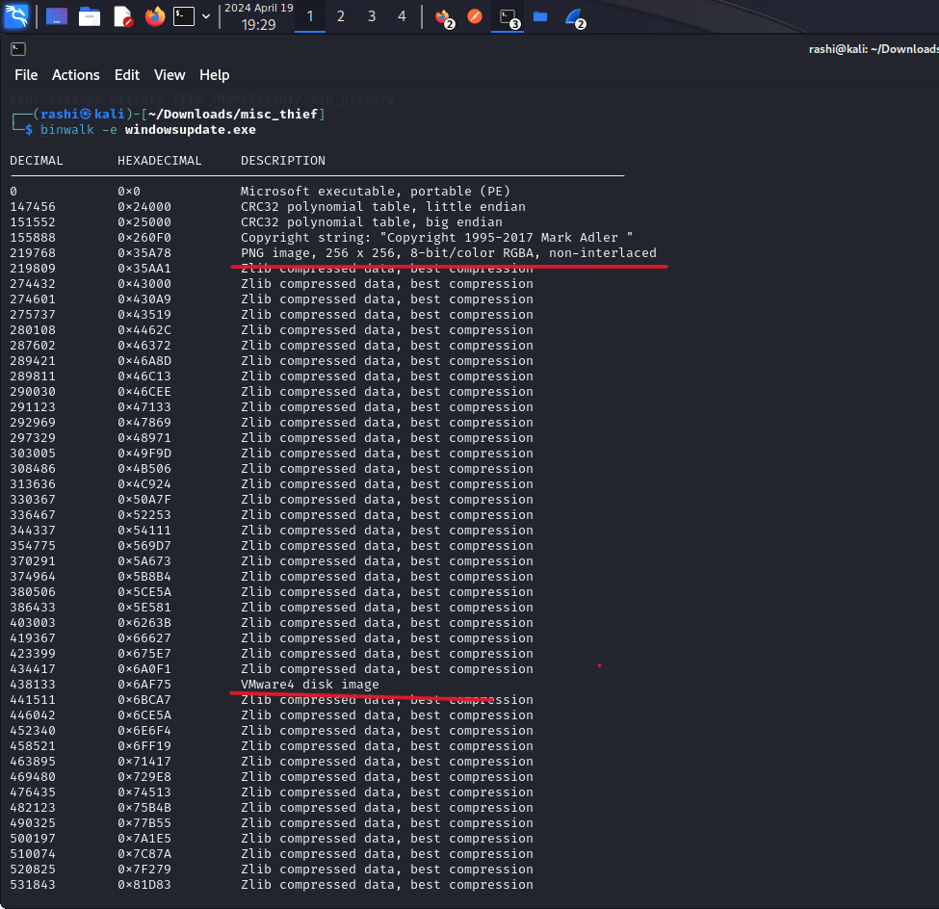
BinWalk
Binwalk is tool used for identifying files and executable code inside of a binary image.
When the exe file was given to binwalk, it was able to identify the PNG Image and a VMware disk image.

Slide 9
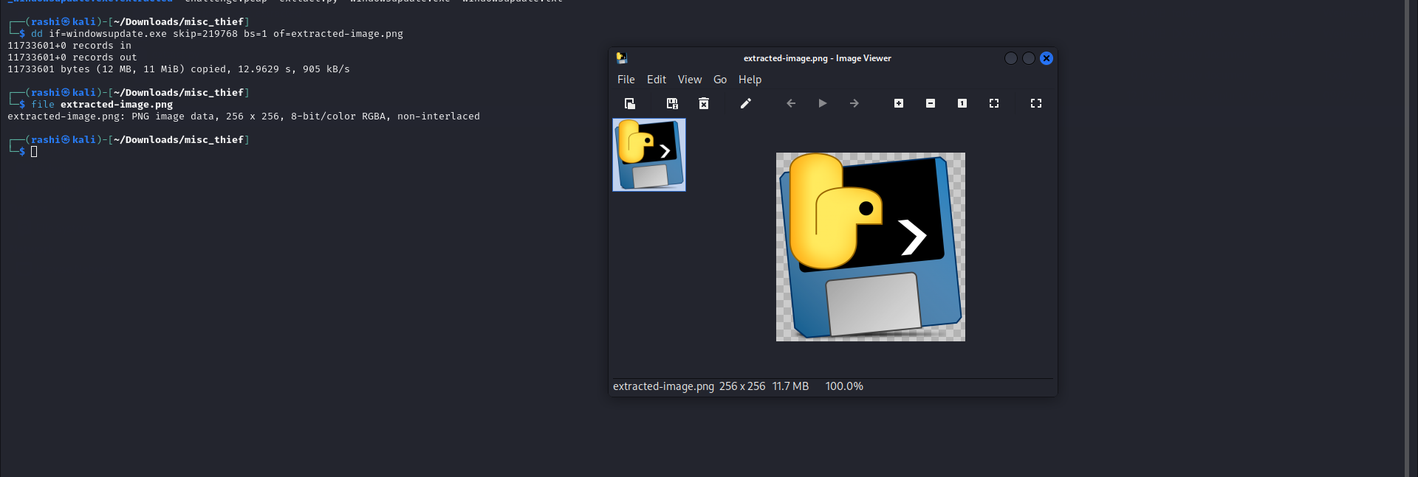
Extracting PNG file
Using the offset from binwalk and using dd (command line utility) to copy and create a new png image and save.
We have used Scalpel and foremost to validate.

Slide 10
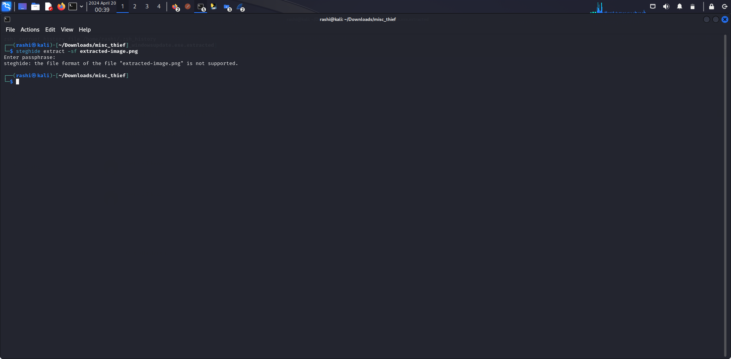
Steghide
Tried to use Steghide to extract information from the extracted image.

Slide 11
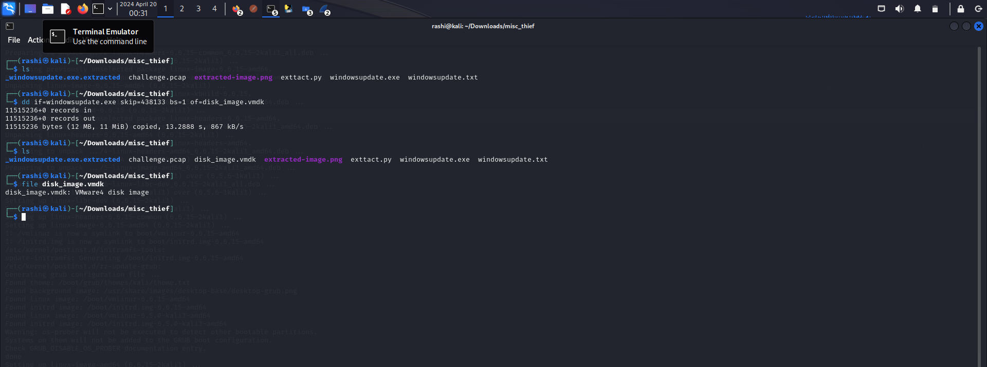
Extracting VMDK file
Similar to PNG file, We have extracted vmdk file using dd.

Slide 12
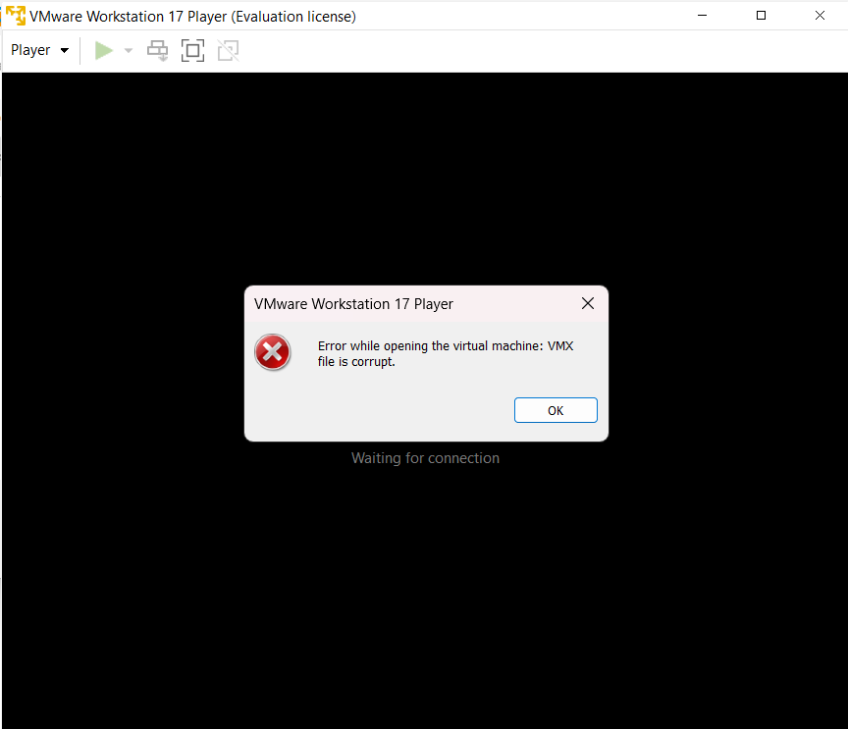
VMware
When tried to open the extracted vmdk file in virtual disk using vmware, vmdk file seemed to be corrupted and could not open.

Slide 13
Conclusion
By working on this project our skills were enhanced specifically in network trffic analysis with wireshark and reverse engineering
We were able to identify the initial cause of the high traffic and extract the object from network traffic.
Was able to reverse engineer and extract png file from exe and validate it with other tools.
We were unable to find any Flags.

Slide 14
Thank You

